Slide 1
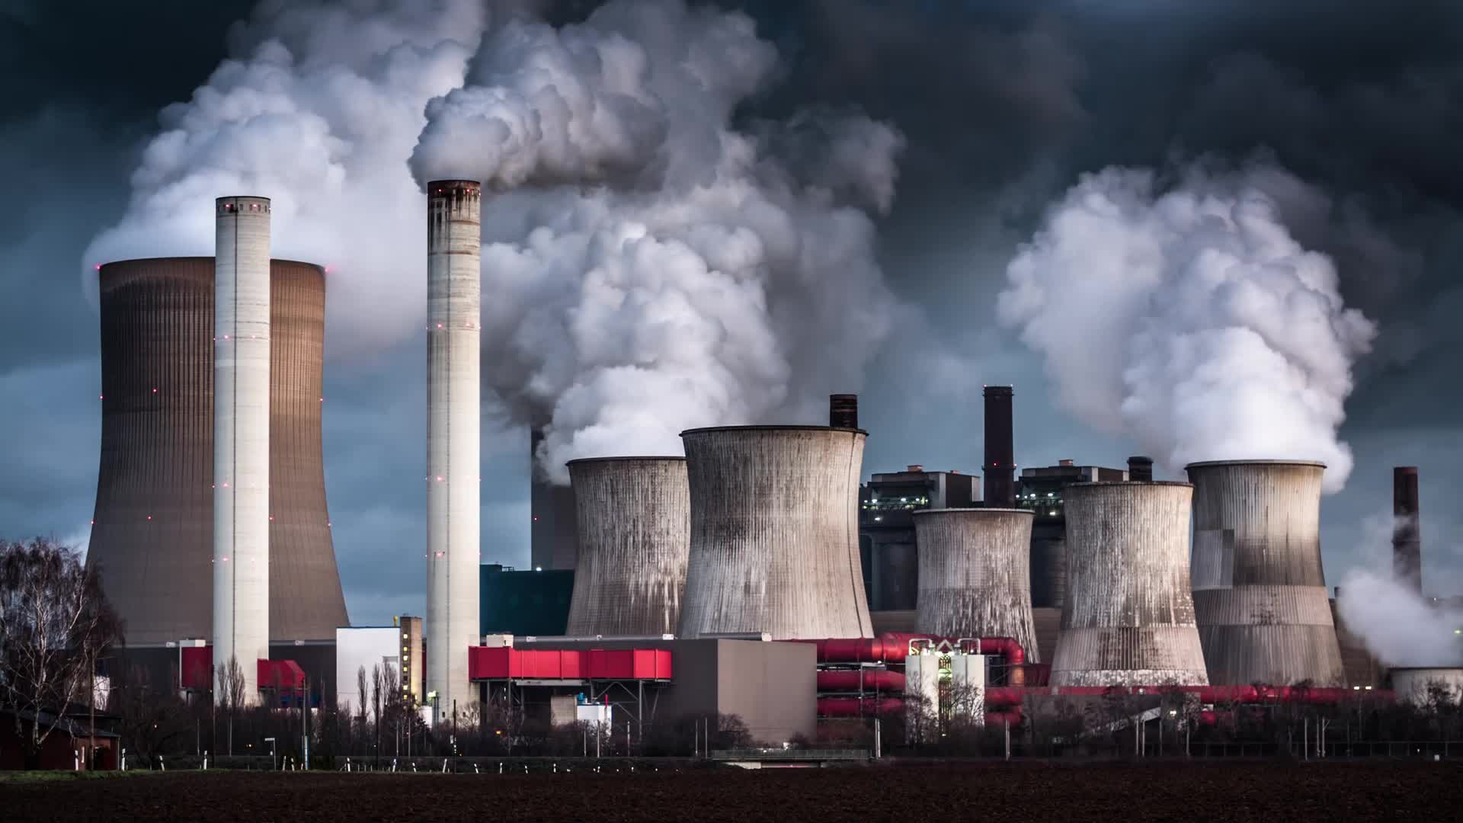
Waste Generation Assessment and the Viability of Generating Electricity
By Syed Ali Mashood Naqvi

Slide 2

Objectives
Overview
Data Collection
ETL Process
Data Storage
Data Preprocessing
Data Visualization
Results
Recommend

Slide 3
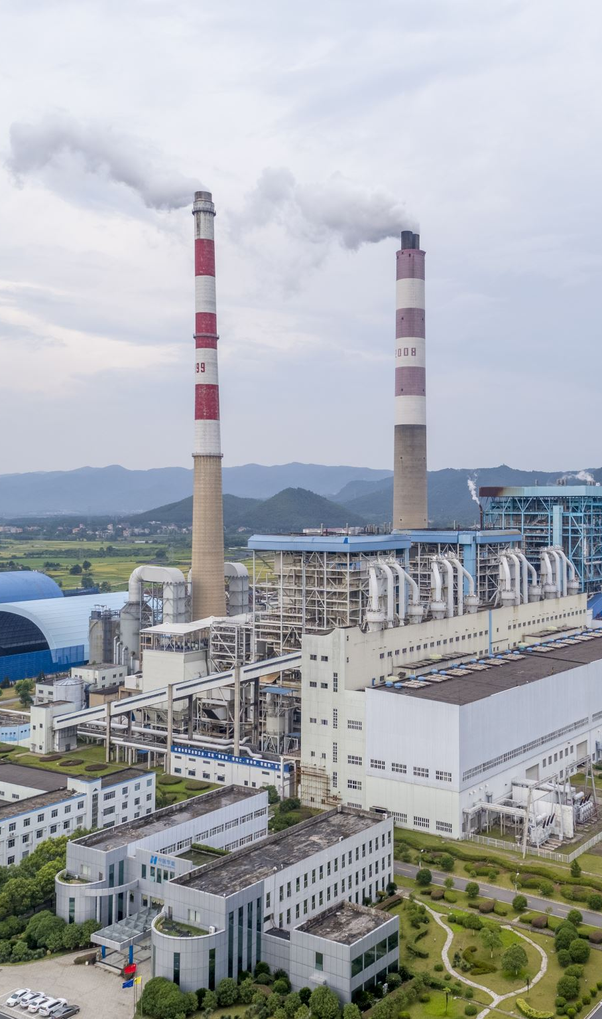
Overview
Waste Generation assessment is the process of identifying and quantifying the types and amount of waste produced by different units.
Generating electricity from Waste can reduce Greenhouse gas emissions, minimize landfill space and increase energy security.
Current estimates suggests that Humankind produces approx. 2 Billion tons of wastes per year.
Typical range of net electricity that can be produced by waste is about 500-600KWh.
Thus, approx. 1200MWh of energy can be produced by 2,200 tons of waste per day.

Slide 4

Data Collection
The primary data collection method involves examining various databases.
The most significant database utilized is "Genesis," which contains comprehensive statistics on Germany.
Two files were deemed essential for this particular case study: one file displays waste type and generation per state, while the other file represents various types of waste generation.
Both of these files are imported into Excel format for analysis

Slide 5

Simple cleaning is done in these files.
Columns are made in order and other un-necessary text is removed such as logo of the organization and its sign mark.
The data is then made in order and then each column is properly named and any irregularities if discovered are eliminated.
This data is then properly structured in a table format for each of the files.
These data files are then imported into a Jupyter notebook.

Slide 6

Data Integration(Extract Transform Load (ETL))
The first step of this phase is importing the data into Python Jupyter notebook.
In the extraction phase, the relevant features are identified and merged into a consolidated dataset.
Analysis revealed that the dataset containing waste generation details per state had more columns.
The dataset with information about different waste types had similar columns, except for two categorical columns.
The two categorical columns from the waste types dataset were merged with the waste generation per state dataset.

Slide 7
Data Integration(Extract Transform Load (ETL))
In the transform phase, columns with a significant number of null values were identified within the dataset.
Two columns, "Waste_to_preparatory_process" and "Output_ratio_of_waste_treatment_plants," had a substantial number of null values and were removed from the dataset.
The goal was to ensure that the data was as accurate and consistent as possible.
Rows with any type of null value were identified and removed.
Of the nearly 960 rows, about half were eliminated, leaving a total of 452 rows of real-world data.

Slide 8

Data Storage
To store the dataset, it was saved into a PostgreSQL database, which was demonstrated.
Python was utilized for this task, and Psycopg2 was employed to connect with the PostgreSQL database.
The Psycopg2 library established an Engine that enabled the Python code to communicate with the PostgreSQL database.
The code was then written into the database in the form of a table.
Finally, the connection was terminated by closing it down.

Slide 9

Data Processing
Initially, we conducted feature engineering by extracting useful information from the data.
The "Total waste generated" column was created by summing all relevant waste types in the dataset.
The "Total recovered materials" column was generated by summing all relevant recovered data.
"Electricity generation potential" was calculated by multiplying the potential of electricity per ton by the waste and recovered materials.
"Waste treatment rate" was calculated by dividing output to input waste in waste treatment plants.
"Average waste generation" was computed by grouping the waste generated by state and transforming it by its mean.

Slide 10
Data Processing
After feature engineering of the columns, we addressed categorical features in plants type, waste types, and categories, which are the sources of wastes.
Each category in these feature columns was grouped into five corresponding groups based on similar characteristics and features.
The categorical features were then mapped into similar categories to reduce category sizes.
To reduce bias in the data and scale its features, we normalized our data.
Normalization was performed because it scales the data features and reduces bias.

Slide 11
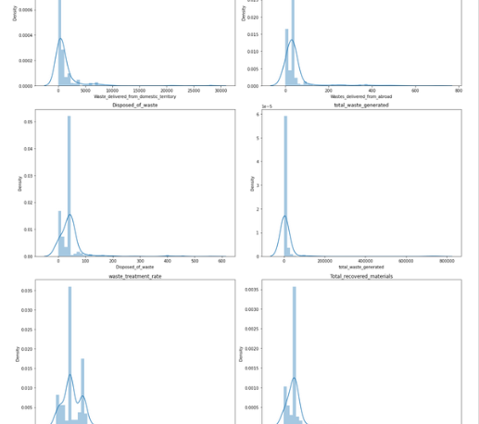
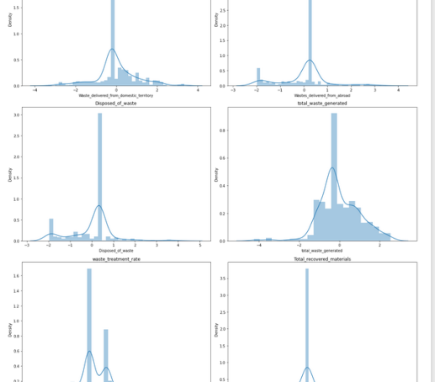
Data Processing
Before normalization our data was highly skewed.
As you can see the data is highly skewed.
In order to scale our data, we used, Power Transformer with Yeo-Jhonson method to reduce the denormalization.
This method although not completely but fairly normalized our data.
However, complete normalization is still not possible because of nature of data.
Fig-1 shows before normalization, while fig-2 shows after normalization data.

Slide 12
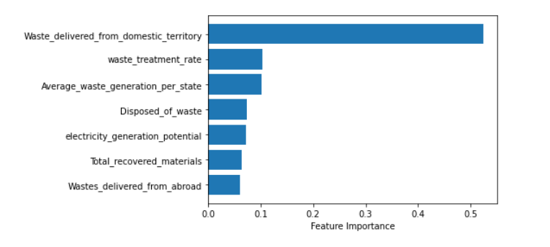
Data Processing
In the last step of data processing, we estimate the feature importance in the dataset with respect to our target variable.
The “target variable” in our case is “Total Waste Generation”.
Random Forest Regressor was utilized for this instance and data was divided into X_Train and X_test , Y_train and Y_test data.
The feature importance was estimated to check which feature is more significant and has close relation with the the target variable.
It was found out waste produced domestically had more correlation with the target variable.

Slide 13
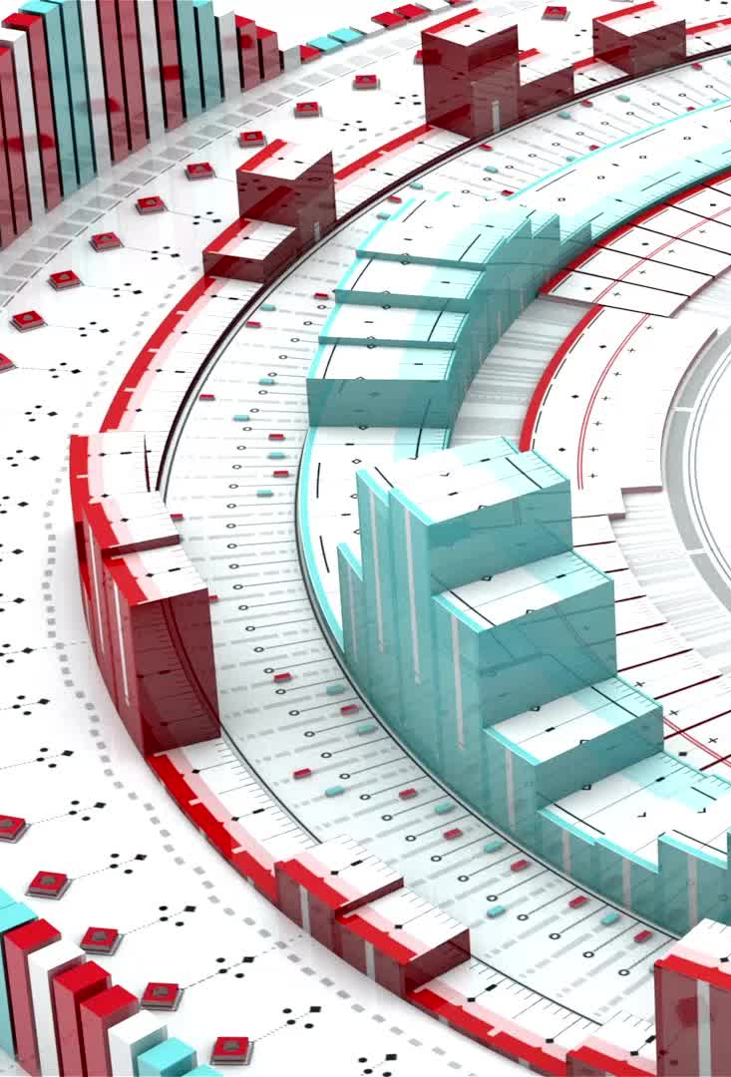
Data Visualization
In this segment, we performed data visualization using PowerBI.
Four charts were created in PowerBI to represent an overall analysis of waste generation, a general analysis of different features of waste generation, waste generation produced domestically, and waste generation imported from abroad.
Each segment had six charts, with each chart representing a particular feature.
Different filters were also applied, mainly on categorical variables, and two slicers were used.

Slide 14

Results
Nordrhein-Westfalen has the highest amount of total waste recovered.
The figures for waste generation and electricity generation potential have decreased over the course of four years.
Hamburg has the highest amount of total waste generated.
Domestically generated waste far exceeds the amount of waste imported or delivered from abroad.
The industrial sector is the major constituent of waste.
The Materials Manufacturing industry is the primary contributor to waste generation.

Slide 15

Recommendations
Nordrhein-Westfalen is the most suitable state for constructing Waste-to-energy plants as it has the highest amount of recoverable waste materials.
Bayern, which produces the most recoverable solid waste, may be a more feasible location for a power plant generating electricity from Municipal Solid waste. Biogas-based power plants can also be constructed in Bayern.
Sachsen, which produces the most biomass, could be a suitable location for a biomass-based power plant.
The overall feasibility of total electricity generation is discouraged due to a declining trend over the past four years.

